Slide 1
Information Spread and Influence Maximization in Social Networks
Agowun Muhammad Altaf - A00448118

Slide 2
Influence Maximization
Choosing the best set of people (seeding set) to maximize the spread of information across a social network.
Uses:
Viral marketing
Disease spreading
Assessing cascading failures within complex systems

Slide 3
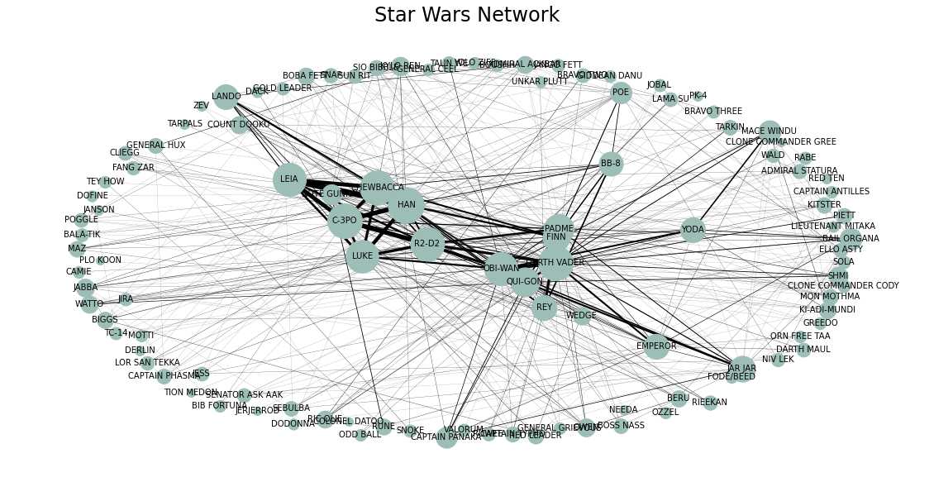
Data set used for this presentation
Star Wars social network.
Nodes are characters.
Edges created between nodes if they appear in the same scene.
Weight the number of scenes they are seen together.

Slide 4
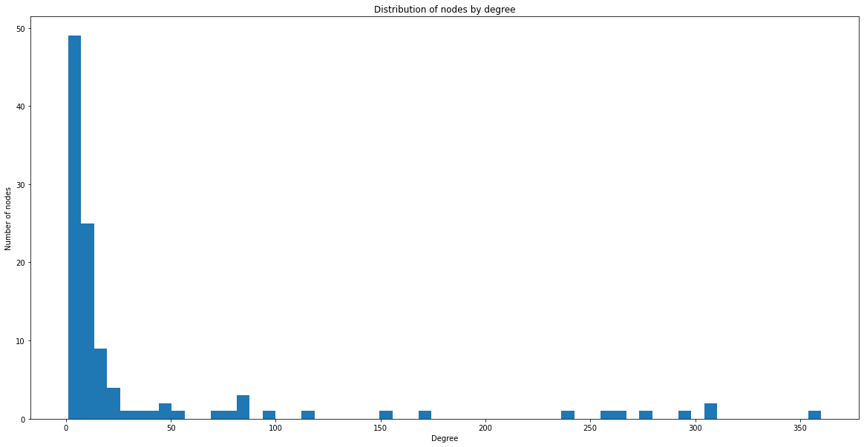
Most Real-world Network usually have a Power Law Distribution
(for this network)

Slide 5
Measures of centrality
Degree: degree of a node is defined as the number of direct connections a node has with other nodes.
Weighted Degree(Eigenvector Centrality): is an algorithm that measures the transitive influence of nodes. Relationships originating from high-scoring nodes contribute more to the score of a node than connections from low-scoring nodes. A high eigenvector score means that a node is connected to many nodes who themselves have high scores.
Closeness: closeness centrality metric defines the importance of a node in a graph as being measured by how close it is to all other nodes in the graph.
Betweenness: This metric defines and measures the importance of a node in a network based upon how many times it occurs in the shortest path between all pairs of nodes in a graph.

Slide 6
Measures of centrality
Top characters based on respective measure of centrality
Budget | Degree | Weighted Degree | PageRank | Betweenness
1 | DARTH VADER | HAN | DARTH VADER | DARTH VADER
2 | OBI-WAN | C-3PO | HAN | C-3PO
3 | C-3PO | DARTH VADER | OBI-WAN | OBI-WAN
4 | PADME | CHEWBACCA | C-3PO | LEIA
Virality rate (ratio of the graph that was influence)
Budget | Degree | Weighted Degree | PageRank | Betweenness
1 | 0.16 | 0.17 | 0.16 | 0.14
2 | 0.16 | 0.17 | 0.17 | 0.17
3 | 0.17 | 0.17 | 0.18 | 0.17
4 | 0.18 | 0.17 | 0.18 | 0.18

Slide 7
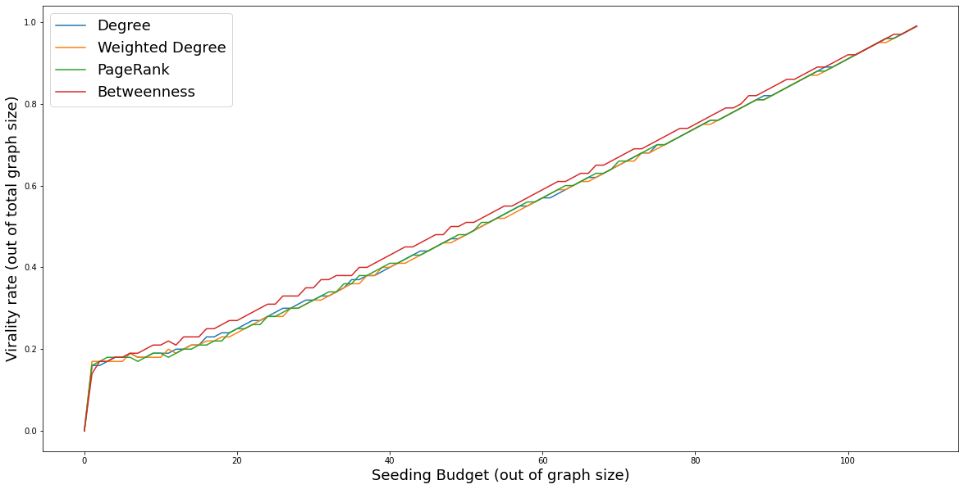
Measures of centrality

Slide 8
Diffusion Models
Independent Cascade
Linear
Threshold
Stored
Diffusion

Slide 9
Independent Cascade
max_weight = max([e[2]['weight'] for e in starwars.edges(data=True)])
def independent_cascade(G,t,infection_times):
# get the nodes that will try to influence the network for time t
current_infectious= [n for n in infection_times if infection_times[n]==t]
# loops through the nodes
for n in current_infectious:
# loops through the neighbors of the selected node
for v in G.neighbors(n):
# check if the neighbor selected is not already influenced
if v not in infection_times:
# try to influence the node
if G.get_edge_data(n,v)['weight'] >= np.random.random()*max_weight:
infection_times[v] = t+1

Slide 10
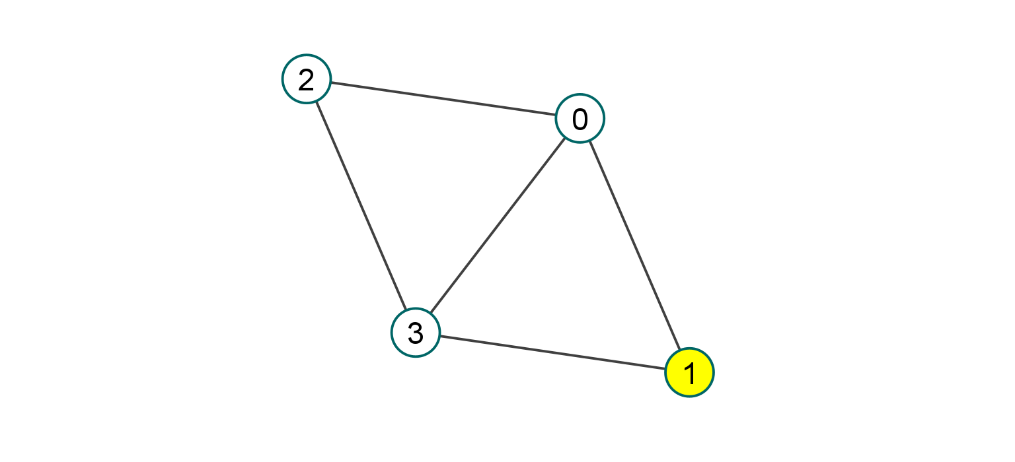
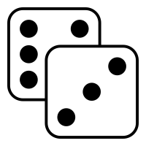
Independent Cascade (t = 0, seed = {1})

Slide 11
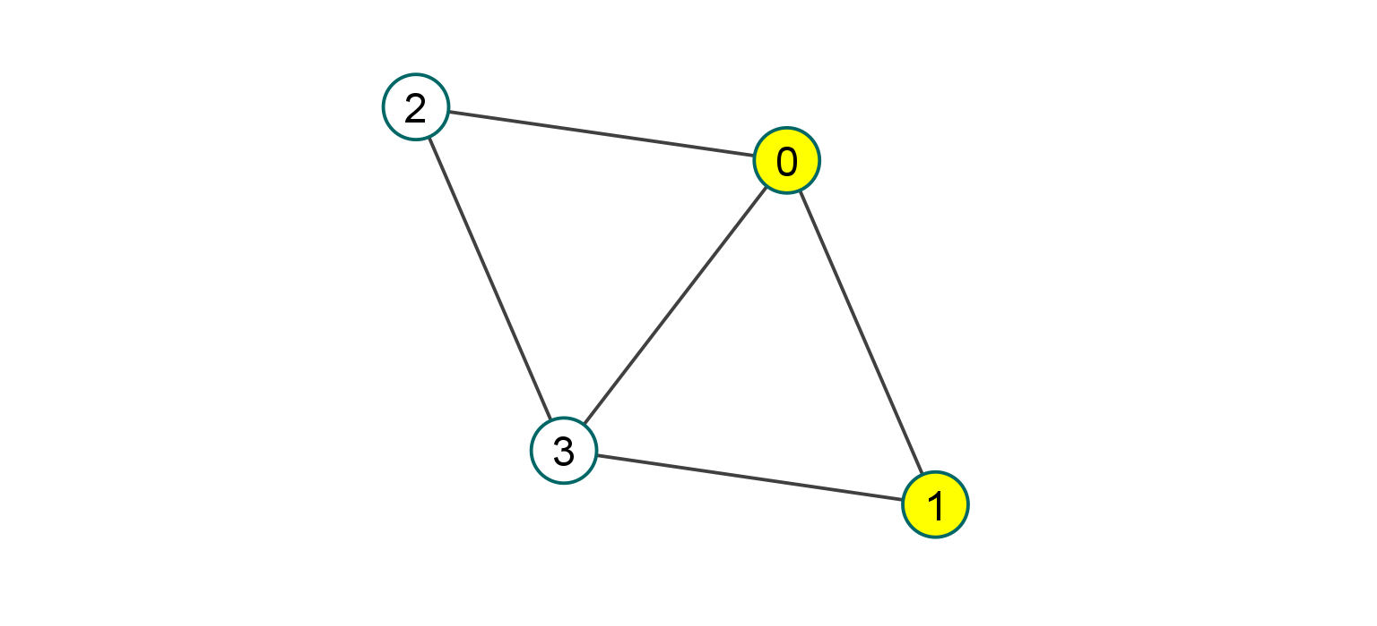
Independent Cascade (t = 0, seed = {1})

Slide 12
Independent Cascade (t = 1, seed = {1})

Slide 13
Independent Cascade (t = 2, seed = {1})
Only node 1 and 0 influenced

Slide 14
Independent Cascade
Seed Set Size | Time(s) | Virality Rate | Characters
1 | 0 | 0.18 | ‘PADME'
2 | 9 | 0.21 | 'OBI-WAN', 'BRAVO THREE'
3 | 443 | 0.22 | ‘JESS', 'C-3PO', 'BOSS NASS'
4 | 15925 | 0.25 | 'ORN FREE TAA', 'RUNE', 'BOBA FETT'

Slide 15
Diffusion Models
Independent Cascade
Linear
Threshold
Stored
Diffusion

Slide 16
Linear Threshold
max_weight = max([e[2]['weight'] for e in starwars.edges(data=True)])
def linear_threshold(G, t, infection_times, threshold_ratio):
# calculate the threshold to be reached for infection
threshold = threshold_ratio * max_weight
current_infectious = [n for n in infection_times if infection_times[n]==t]
# loops through the infected nodes
for n in current_infectious:
# loops through the neighbors of the selected node
for v in G.neighbors(n):
# check if the neighbor selected is not already influenced
if v not in infection_times:
# add influence to the neighbor
nx.set_node_attributes(G, {v:{"influence":G.nodes[v]["influence"] + G.get_edge_data(n,v)['weight']}})
# check if the node was influenced
if G.nodes[v]["influence"] >= threshold:
infection_times[v] = t+1
return infection_times

Slide 17
Linear Threshold (t = 0, seed = {1})

Slide 18
Linear Threshold (t = 0, seed = {1})

Slide 19
Linear Threshold (t = 1, seed = {1})

Slide 20
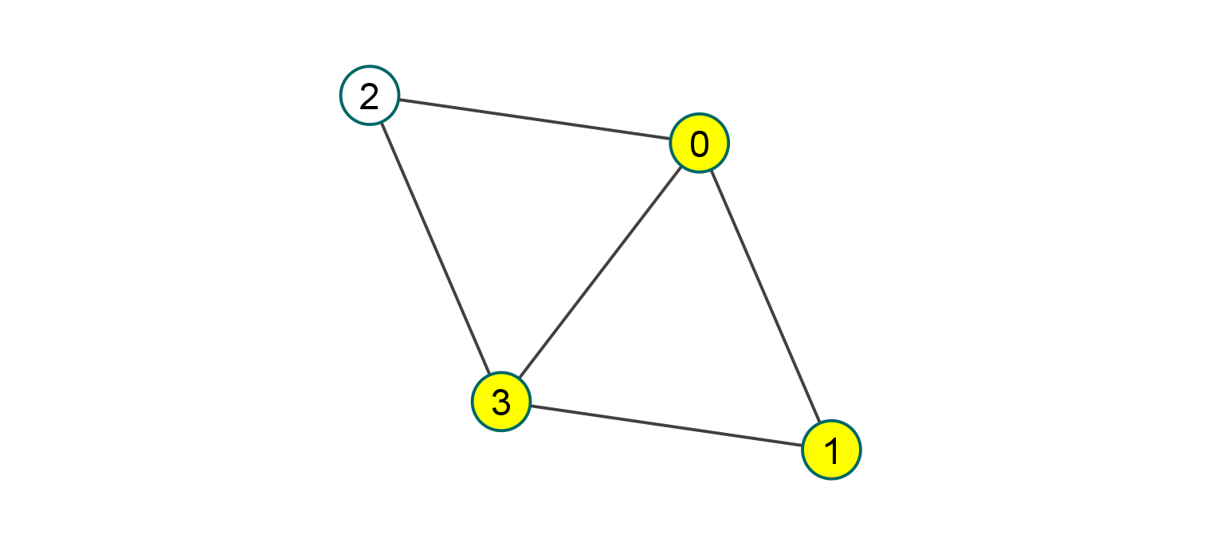
Linear Threshold (t = 2, seed = {1})

Slide 21
Linear Threshold (t = 3, seed = {1})
Only node 1, 0 and 3 influenced

Slide 22
Linear Threshold
Seed Set Size | Time(s) | Virality Rate | Characters
1 | 0 | 0.18 | ‘C-3PO'
2 | 9 | 0.2 | 'ELLO ASTY', 'C-3PO'
3 | 312 | 0.21 | 'NIV LEK', 'YOLO ZIFF', 'C-3PO'
4 | 8741 | 0.22 | 'NIV LEK', 'YOLO ZIFF', 'JESS', 'C-3PO'

Slide 23
Diffusion Models
Independent Cascade
Linear
Threshold
Stored
Diffusion

Slide 24
Stored Diffusion
def stored_diffusion(G,t,infection_times):
# get the nodes that will try to influence the network for time t
current_infectious = [n for n in infection_times if infection_times[n]==t]
# loops through the nodes
for n in current_infectious:
# get influence from stored
for v in nodes_influence[n]:
# check if the node already influenced
if not v in infection_times:
infection_times[v] = t+1
We first need to store the influence of each node
def store_influence(G):
# loop through the nodes
for n in G:
# calculate and store the neighbors of the node n that will be influenced by it
nodes_influence[n] = get_influence(G, n)

Slide 25
def get_influence(G, n):
# max_weight use to calculate influence
max_weight = max([e[2]['weight'] for e in G.edges(data=True)])
# number of trials since infleunce is random
trials = 20
# minimum amount of trials for which the node has to be influence to be marked as influence
influence_threshold = trials / 5.2
# store the nodes that are being influence by the node
n_influence = []
# loop through the neighbors of the node n
for v in G.neighbors(n):
# the number of trials for the node was influenced
influenced_trials = 0
# run multiple trial
for i in range(trials):
# try to infleunce
if G.get_edge_data(n,v)['weight'] >= np.random.random()*max_weight:
influenced_trials += 1
# check if number of trials where the neighbor got influence is greater than the threshold
if influenced_trials > influence_threshold:
# mark the neighbor as a node that will be influence by the node
n_influence.append(v)
return n_infleunce

Slide 26
Stored Diffusion
Seed Set Size | Time(s) | Virality Rate | Characters
1 | 0 | 0.21 | ‘CAMIE'
2 | 0 | 0.23 | 'GENERAL HUX', 'CAMIE'
3 | 10 | 0.25 | ‘GENERAL HUX', 'CAMIE', 'RUNE'
4 | 289 | 0.25 | 'NIV LEK', 'POE', 'GENERAL HUX', 'RUNE'

Slide 27
Time Comparison

Slide 28

Visualizing diffusion
Seed set = {NIV LEK, JABBA, YOLO ZIFF}

Slide 29
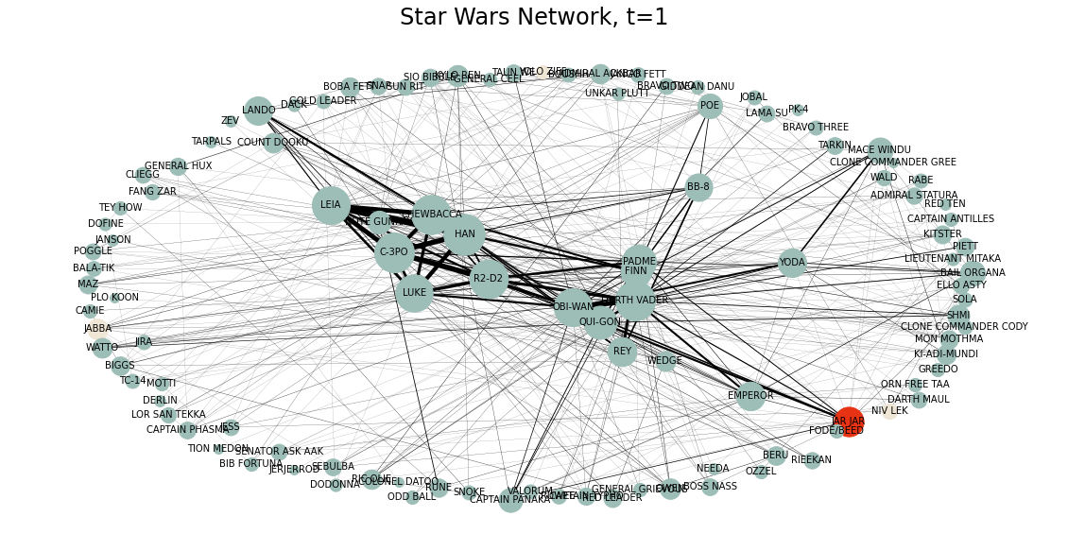
Visualizing diffusion

Slide 30
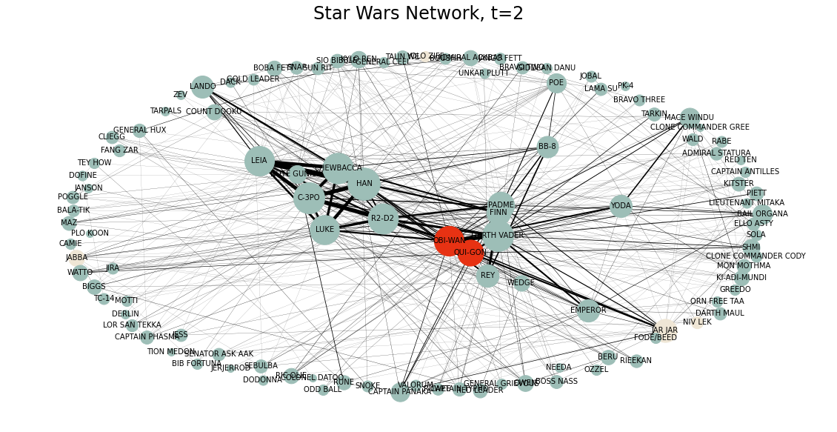
Visualizing diffusion

Slide 31
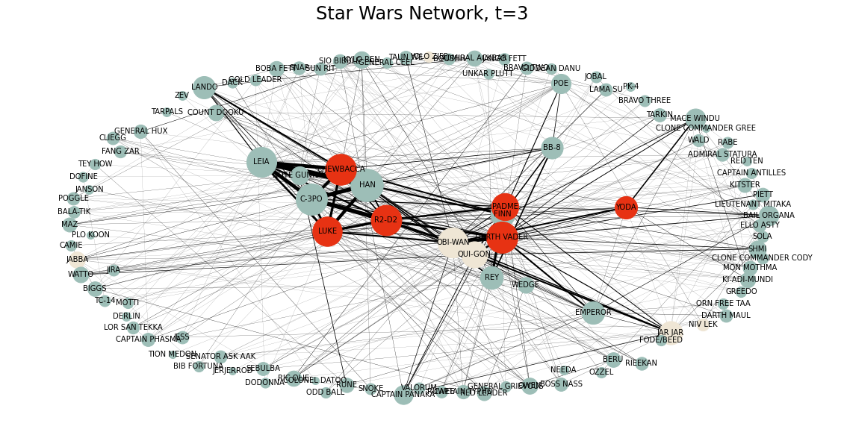
Visualizing diffusion

Slide 32
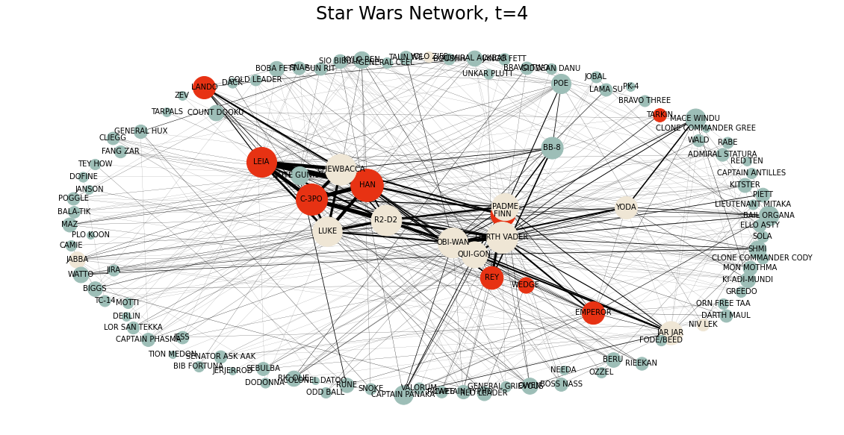
Visualizing diffusion

Slide 33
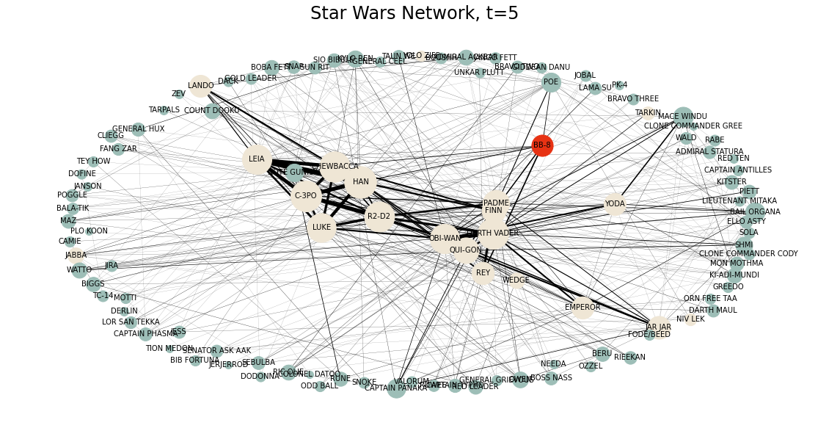
Visualizing diffusion

Slide 34
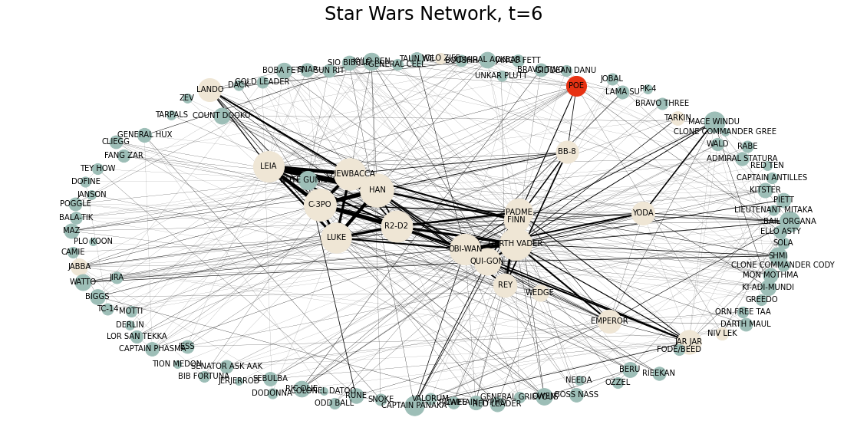
Visualizing diffusion

Slide 35
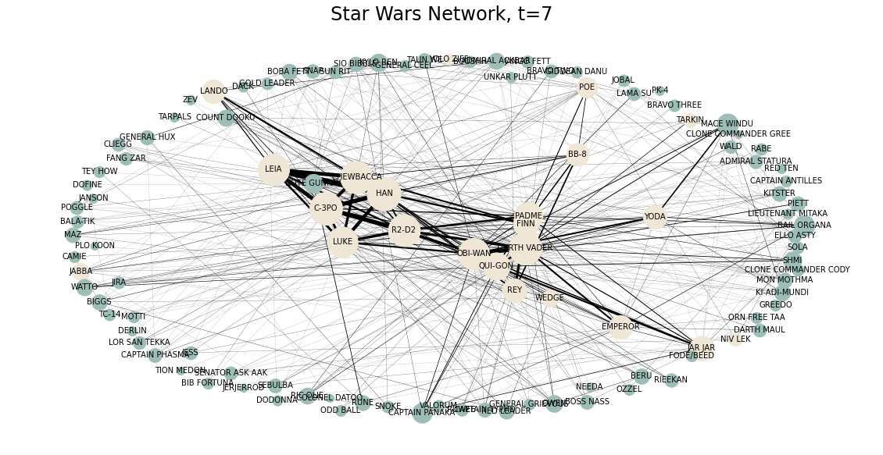
Visualizing diffusion

Slide 36
Thank You !

